Slide 1
Big Mountain Resort COR.
location: northwestern Montana
Vertical: 2,353 ft (717 m)
Top elevation: 6,817 ft (2,078 m)
Base elevation: 4,464 ft (1,361 m)
Skiable area: 3,020 acres (12.2 km2)
Runs: 93
author: Ruslan S

Slide 2
Objectives:
Recover from the financial loss of $1,500,000 due to the expense of maintaining the new chair lift.
Gain the knowledge of operational business models based on the existing market situation.
Optimize the cost of some services on particular objects.

Slide 3
Possible Targets:
The value of admission during business days and weekends.
The operational cost of some services.
Business model.
Promotions.

Slide 4
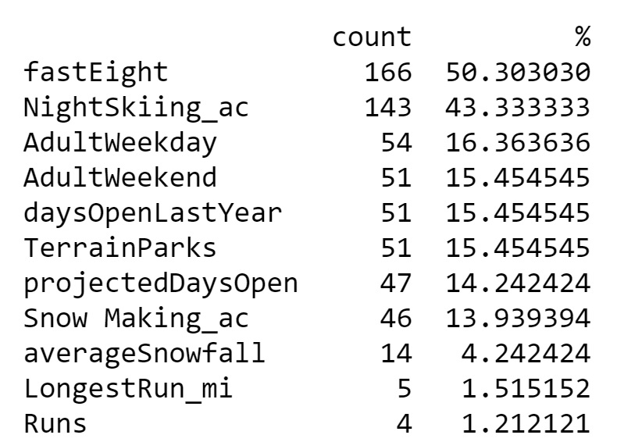
Munging issues:
Missing features (variables) that will affect the performance of the model:
Snow Making_ac
Runs
AdultWeekday
AdultWeekend
NightSkiitn_ac

Slide 5
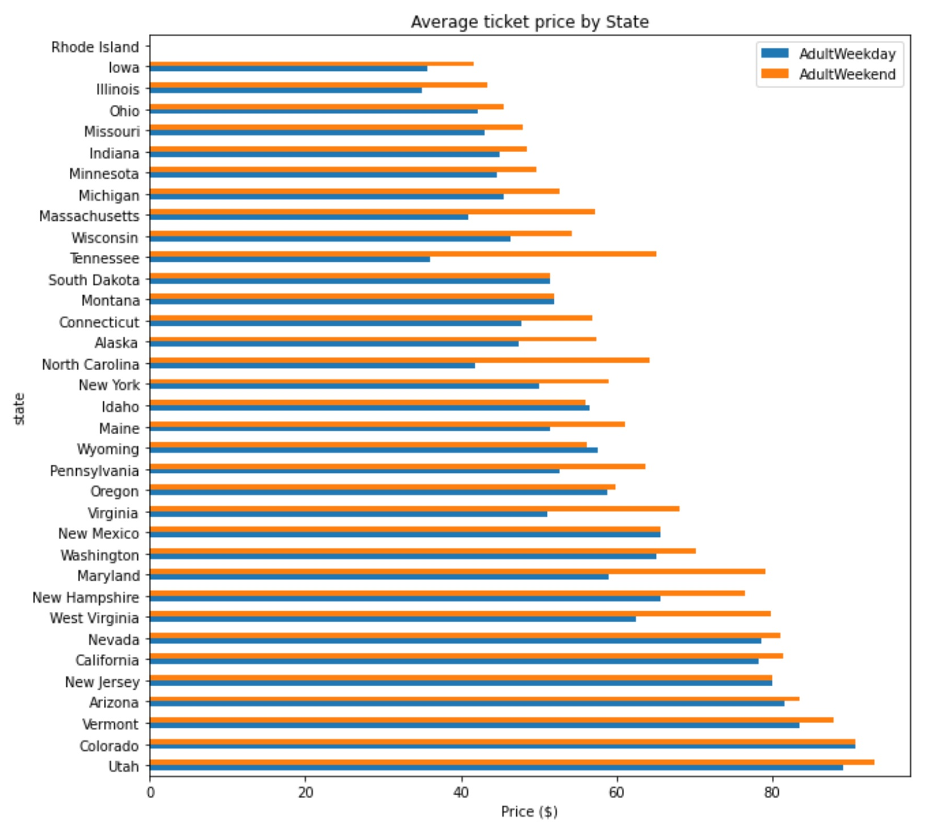
Average ticket price by State:
Key points to take away:
Most prices are in California, Colorado, and Utah.
Some states show more variability than others between weekdays and weekends.

Slide 6
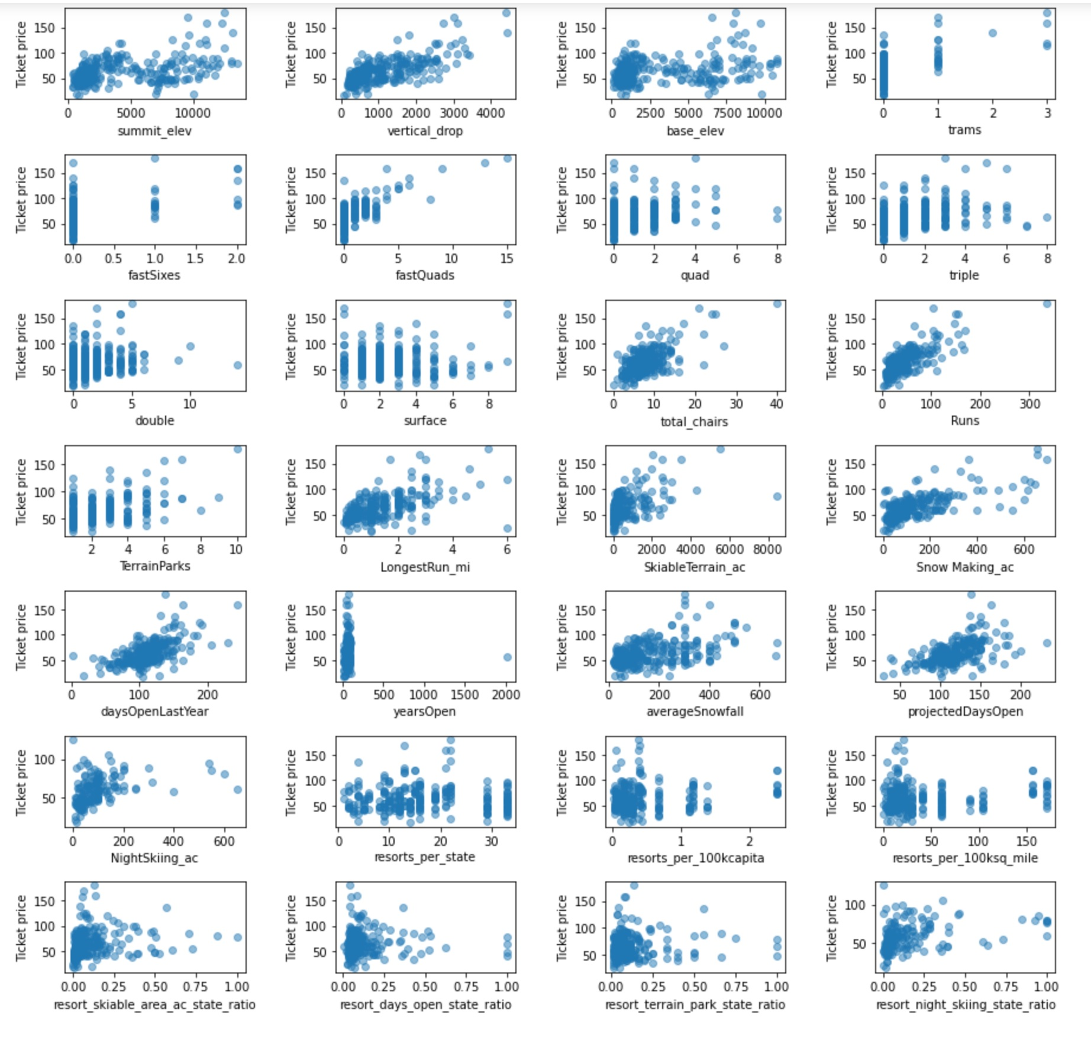
Correlations:
Vertical_drop
FastQuads
Runs
Total_chairs

Slide 7
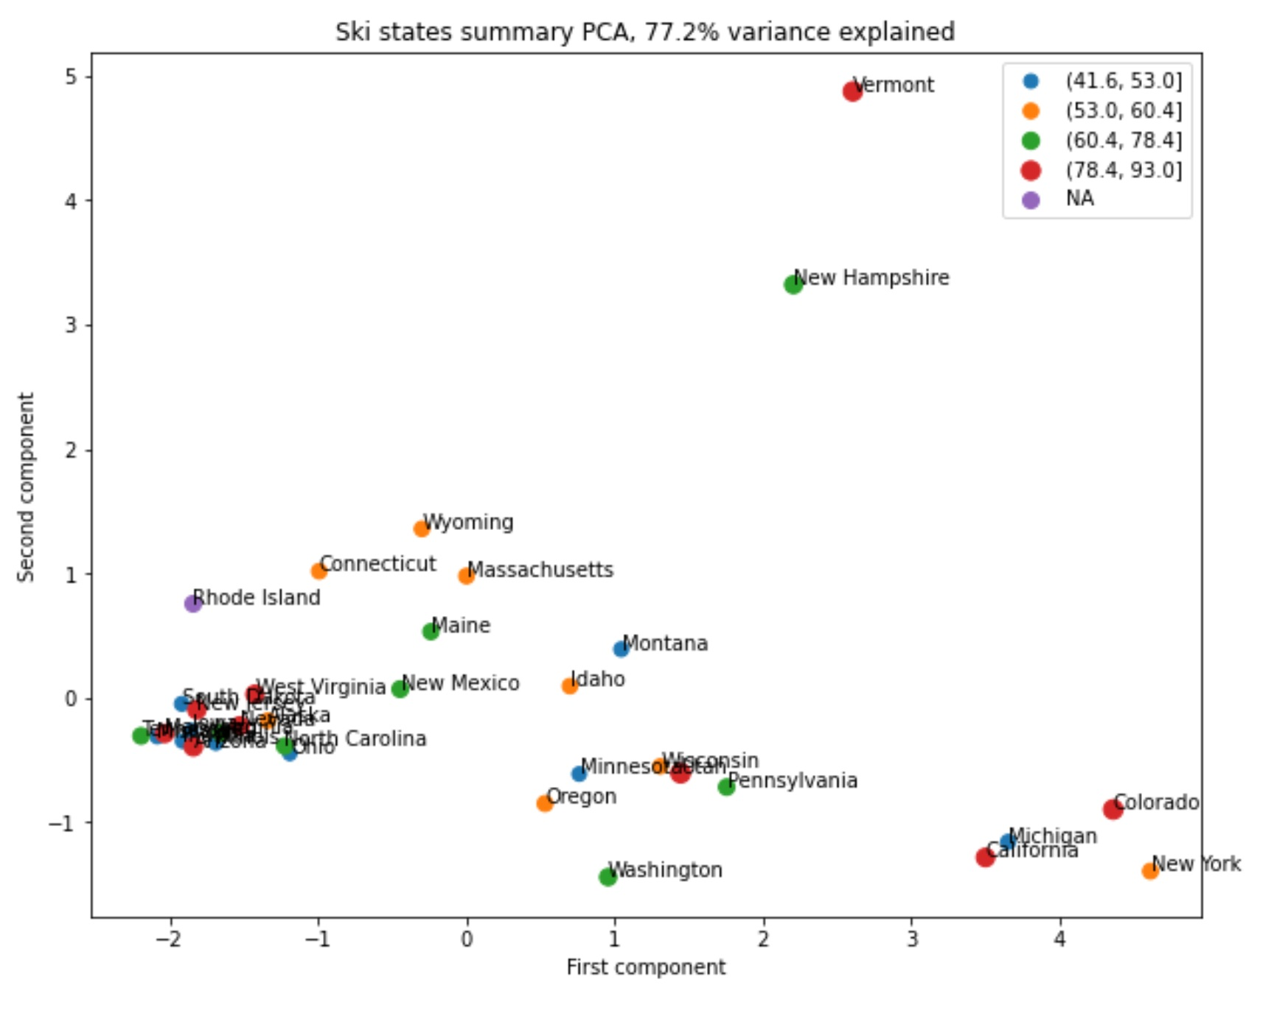
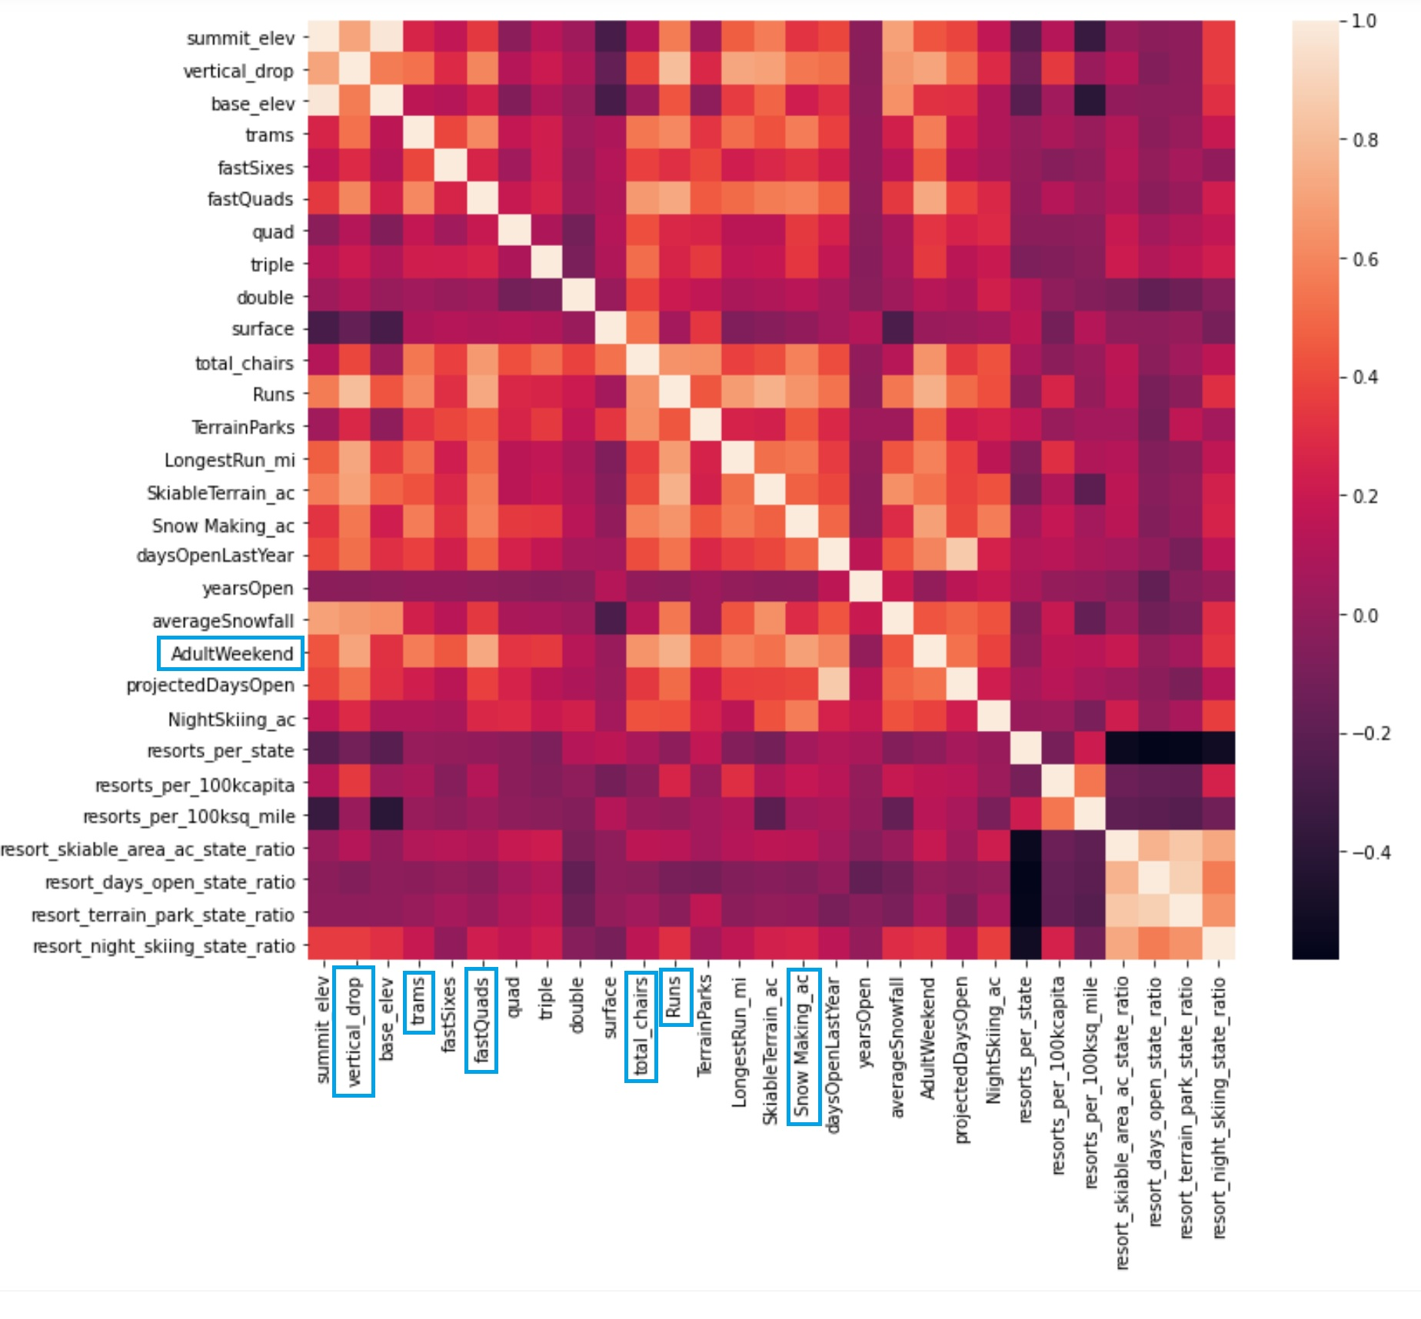
Recommendation and key findings:
No clear relationship between state and ticket
Some valuable correlation among features

Slide 8
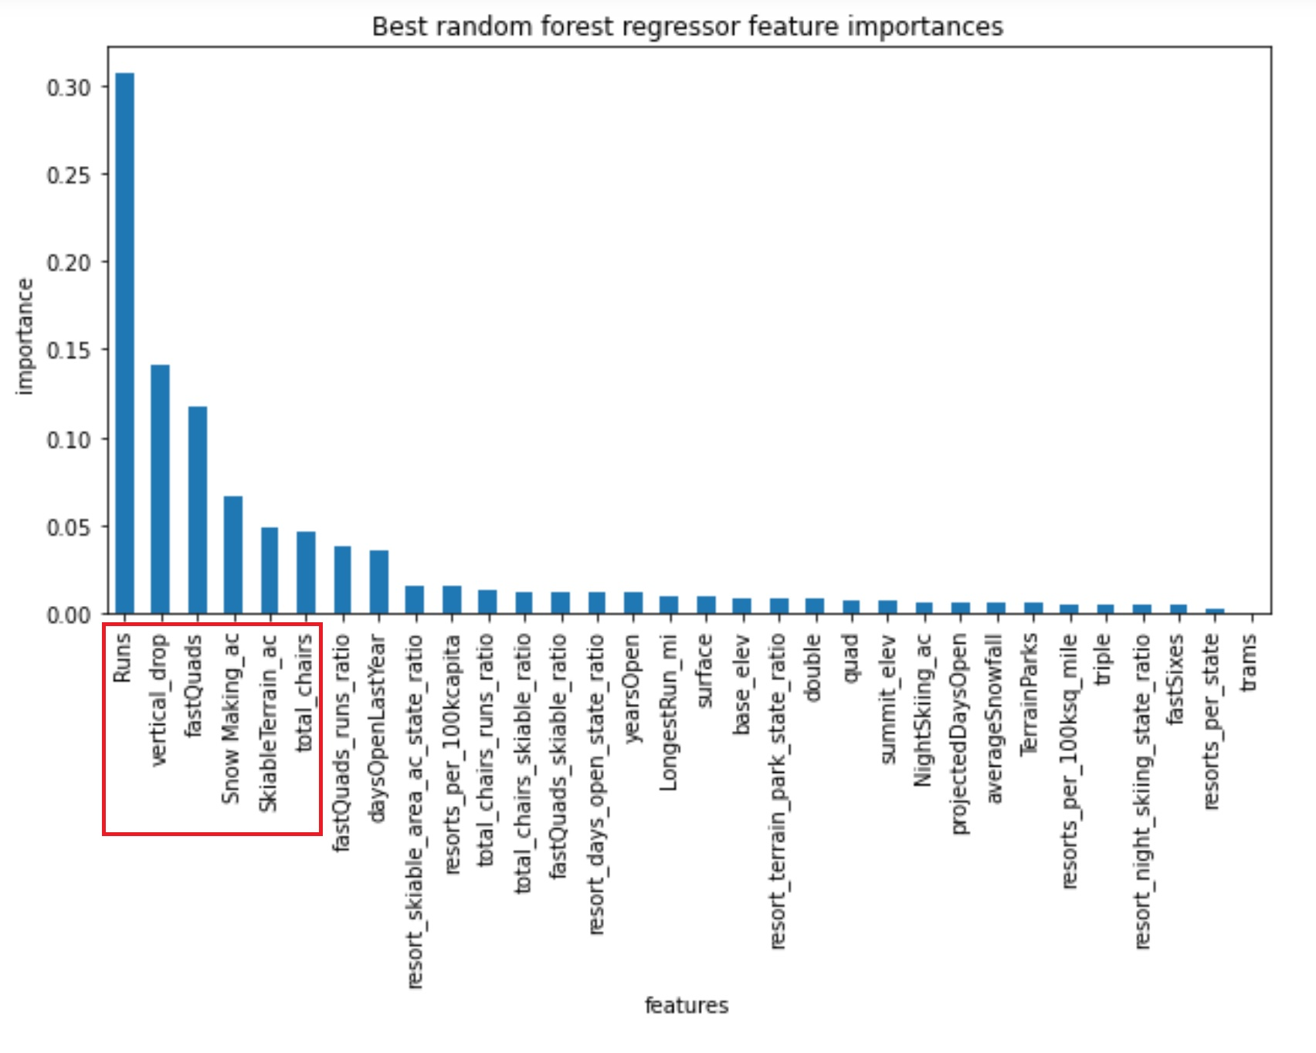
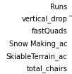
Modeling results and analysis:
Model we used for this task was “The Random Forest”
Main correlations among the existing features

Slide 9
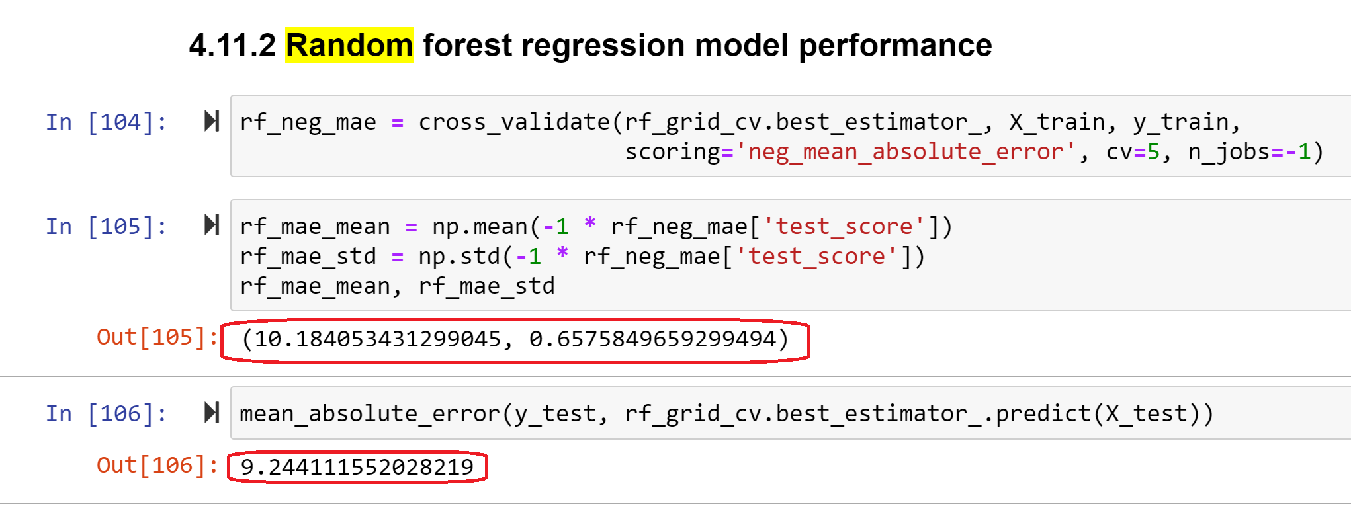
Modeling results and analysis:
The Random Forest model has lowest cross-validation mean absolute error
It produces less variability

Slide 10
Conclusion:
Model works based on the idea that most resorts set their prices according to market support.
Currently, company undercharging for the admission by $5-$10 (within mean absolute error).
Adding new chair lift in the future will not increase the annual revenue (most likely it will decrease it significantly).
Investing in vertical drop will bring increase by $2 on average.
Dropping operational cost on a few runs (3 of them) will save some money.

